Slide 1
Dr. M. EASURAJA
ASSISTANT PROFESSOR
DEPARTMENT OF CHEMISTRY
ARUL ANANDAR COLLEGE (AUTONOMOUS)
KARUMATHUR.

Slide 2
Principle, Instrumentation and Applications of UV – Spectroscopy

Slide 3
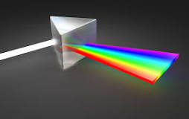
what is Spectroscopy?
it is the study of the absorption and emission of light and other radiation by means of interaction with matter and to measures and interprets the electromagnetic spectra.
Spectrum - image in Latin,
Skopia - observation in Greek.
study

Slide 4
Types:
Molecular, Atomic, Electronic
Ultraviolet-Visible (UV/Vis) Spectroscopy.
Infrared (IR) Spectroscopy.
Raman Spectroscopy.
NMR Spectroscopy. H1 NMR, C13 NMR.
Mass Spectroscopy

Slide 5
UV-Vis Spectroscopy (or Spectrophotometry)
it is a quantitative technique used to measure how much a chemical substance absorbs light. This is done by measuring the intensity of light that passes through a sample with respect to the intensity of light through a reference sample or blank.

Slide 6
Radiation that has both electric and magnetic fields and travels in waves. It comes from natural and man-made sources. Electromagnetic radiation can vary in strength from low energy to high energy. It includes radio waves, microwaves, infrared light, visible light, ultraviolet light, x-rays, and gamma rays.

Slide 7
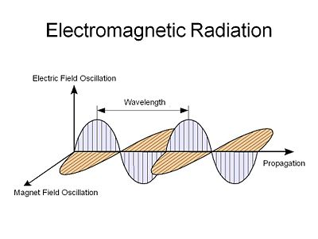

Slide 8
Principle involved
When the interaction between incident radiation and the electron cloud in a chromophore results in an electronic transition involving the promotion of one or more of the outer shell or the bonding electrons from a ground state into a higher energy state, ultraviolet-visible ( UV-Vis) spectra are derived.

Slide 9
Woodward Fieser Rules (1941)
* Acyclic Dienes
* Sixmembered ring Dienes
* α – β unsaturated Dienes
* Polyenes etc.

Slide 10


The acyclic diene base value may be
*Homoannular
*Heteroannular
Base value are:
S – Cis S – Trans
253 nm 215 nm

Slide 11
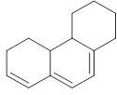
If both the dienes are present
253 nm

Slide 12

Exocyclic conjugated double bonds
Add 5 nm in this case 10 nm

Slide 13
Alkyl substituents and ring residues
Add 5 nm
3x5 = 15 nm 3x5 = 15 nm

Slide 14
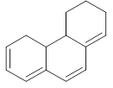
Double bond Extending conjugation
Add 30 nm
2x30 = 60 nm

Slide 15
Add 5 nm for – Cl, Br
60 nm - NR2
30 nm - S alkyl
6 nm - O alkyl

Slide 16

Calculate the λmax
λmax =

Slide 17
Base value = 253
Alkyl subs. 2x5 = 10
Ring resid. 3x5 = 15
Extending Con. 1= 30
Exocyclic 1 = 5
λmax = 313 nm

Slide 18
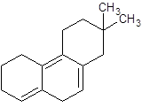

Slide 19
Base value = 253
Alkyl subs. 2x5 = 10
Ring resid. 3x5 = 15
Extending Con. 1= 30
Exocyclic 1 = 10
Exocyclic 2x5 = 10
λmax = 333 nm

Slide 20


Slide 21
Base value = 215
Ring resid. 2x5 = 10
Exocyclic 1 = 5
λmax = 230 nm

Slide 22
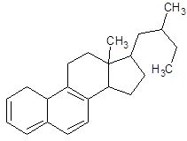

Slide 23
Base value = 253
Ring resid. 5x5 = 25
Extending Con. 2= 60
Exocyclic 1 = 5
λmax = 343 nm

Slide 24
α, β – unsaturated ketones
Base value
Six membered ring = 215 nm
Five membered ring = 202 nm
Unsaturated aldehyde = 207nm
Add 10 for each substituent on
α carbon
12 for β carbon
18 for γ and δ carbon

Slide 25
Add 5 for Ring residue and alkyl substituents
Extending Con. = 30 nm
Exocyclic = 5 nm
If auxochrome like OH present on the positions
α = 35 nm
β = 30 nm
δ = 50 nm
For OAc = 6 nm (α, β, δ)

Slide 26
If OMe present on the positions
α = 35 nm
β = 30 nm
γ = 17 nm
δ = 31 nm
Solvents
Hexane = + 11 nm
Ether = +7 nm
Dioxane = +5 nm
Chloroform= + 1 nm
Water = - 8 nm

Slide 27


Slide 28
Base Value =215 nm
Β alkyl subst. 2x12 = 24 nm
λmax = 238 nm

Slide 29


Slide 30
Base Value =215 nm
α alkyl subst. = 10 nm
β alkyl subst. 2x12 = 24 nm
λmax = 249 nm

Slide 31
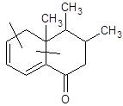

Slide 32
Base Value =253 nm(Cisoid)
Homoannular
α ring residue = 10 nm
δ ring residue = 18 nm
Exocyclic = 5 nm
Extending conj. = 30 nm
λmax = 316 nm

Slide 34
Base Value =215nm(Transoid)
Heteroannular
β ring residue = 12 nm
δ ring residue = 18 nm
Exocyclic 2 = 5 nm
Extending conj. = 30 nm
λmax = 280 nm

Slide 36
Base Value =253 nm(Cisoid)
Homoannular
α ring residue = 10 nm
δ ring residue = 18 nm
δ OH subst. = 50 nm
Exocyclic 1 = 5 nm
Extending conj. = 30 nm
λmax = 357 nm

